Slide 1


KONERU LAKSHMAIAH EDUCATION FOUNDATION
1st REVIEW
Job Portal with Resume Parsing and Matching
A V S N R Akhila | 2520030022
Manasvi Nilesh Ghag | 2520030335
Under the Guidance of
Dr. Spandana. S
Assistant Professor
Department of Computer Science and Engineering

Slide 2



TEAM NUMBER : 12
Name of Candidate | Role
A V S N R Akhila | Team Member
Manasvi Nilesh Ghag | Team Member

Slide 3

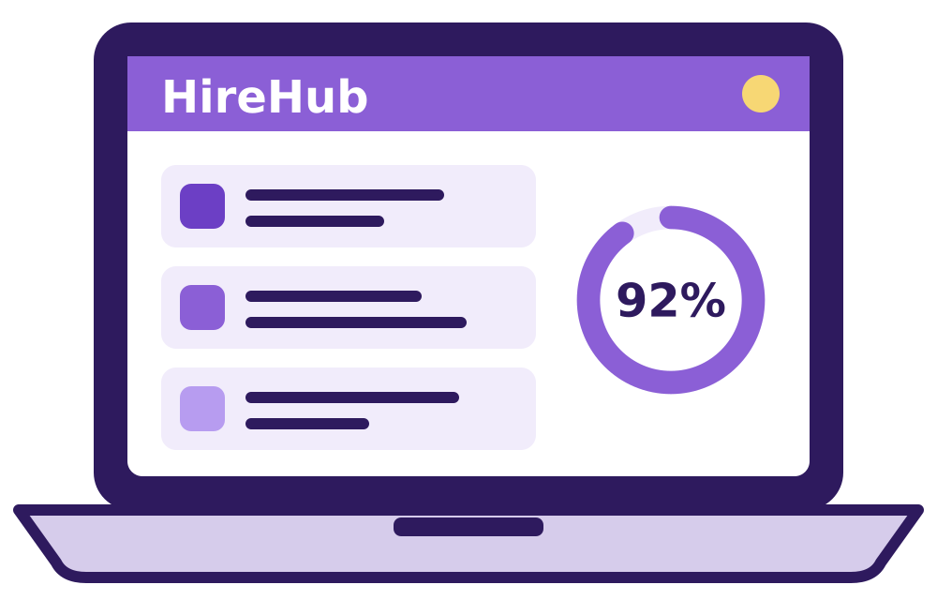
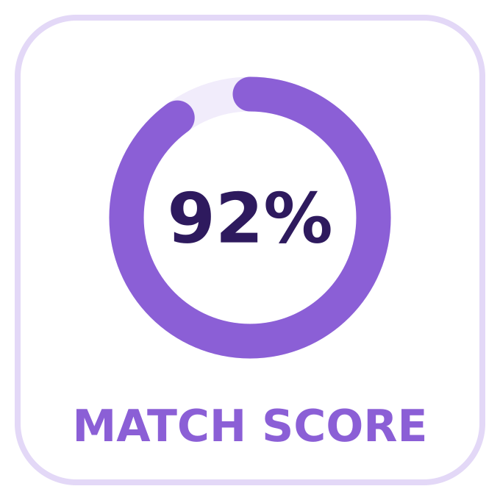
ABSTRACT
HireHub is a smart job portal that makes hiring easier for both job seekers and recruiters. A candidate uploads a resume, and the system reads it automatically to pick out skills, education, experience and certifications. It then compares these details with the needs of each job and gives a match score. Candidates see the jobs that suit them best, and recruiters see the candidates that fit their jobs. This saves time, cuts manual work and makes hiring faster and more accurate.

Slide 4

INTRODUCTION
Today there are thousands of job openings online, so finding the right one is hard for candidates. Recruiters also receive hundreds of resumes and have to read each one by hand. Our Job Portal with Resume Parsing and Matching connects the right candidate to the right job automatically. It reads the resume, understands the important details and matches them with what the job needs. It has separate dashboards for candidates, recruiters and admins, so each user sees only what they need.

Slide 5




EXISTING SYSTEM
Today, candidates search for jobs by hand on many job portals, and recruiters read and shortlist every resume by themselves. This has many limits:
Screening resumes takes a lot of time
Good candidates can easily be missed
Searching and filtering is mostly manual
Recruiters must read resumes one by one
Job suggestions often do not match the candidate's skills
In short: too much manual work makes hiring slow and less efficient.

Slide 6

PROBLEM
Hiring today is slow for both sides. Candidates must scroll through many job posts to find one that fits. Recruiters must open and read every resume one by one. Because of this, good candidates get missed, people apply to the wrong jobs, and hiring gets delayed. So we need a system that can read resumes by itself, compare skills with job needs, and suggest the right jobs and the right candidates.

Slide 7





SOLUTION (Contribution)
We built a smart job portal that does the matching work automatically. The system reads each resume, compares it with every job and shows the best matches, so candidates and recruiters save time and effort.
Upload Resume
Read Resume
Match Score
Recommend
Candidate uploads a resume
→
System picks out skills, education and experience
→
Details are compared with job needs
→
Best jobs and best candidates are shown

Slide 8




OBJECTIVES
To read resumes automatically and pick out the key details.
To match candidates with jobs using skills, education and experience.
To give a match score for better job suggestions.
To help recruiters find the right candidates quickly.
To reduce manual work and save time in hiring.
To make job matching more accurate and efficient.

Slide 9
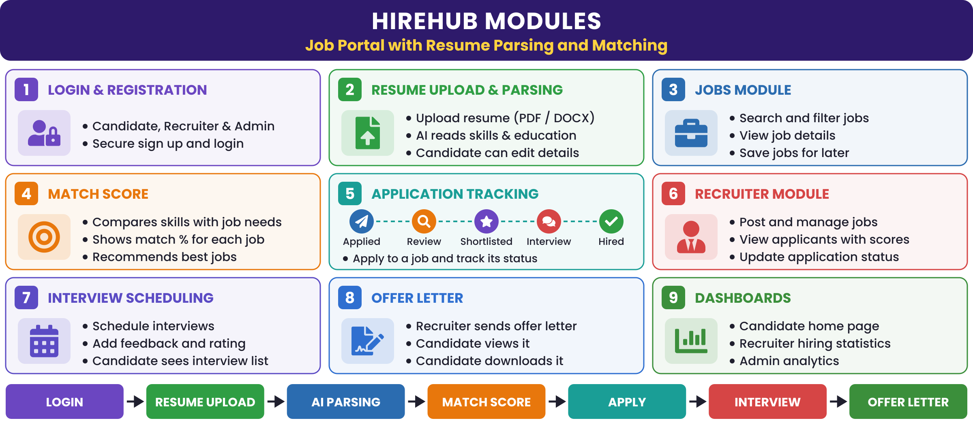






MODULES

Slide 10





SOFTWARE REQUIREMENTS
React.js + Vite – builds the user interface (frontend), styled with plain CSS.
Node.js – runs the server-side (backend) code.
Express – creates the REST APIs that link frontend and backend.
MongoDB – stores users, jobs, resumes and applications.
Gemini AI + Resume Parser – reads resumes and extracts skills and other details.
JWT Authentication – gives secure login with separate access for each role.

Slide 11


CONCLUSION AND FUTURE SCOPE
Conclusion
Future Scope
Our job portal makes hiring simple. It reads resumes automatically and matches them with job needs. This cuts manual work, saves time and gives better job suggestions. Both candidates and recruiters get a faster and more organised hiring process.
Smarter AI/NLP for more accurate resume reading
Machine-learning based job recommendations
Support for more resume formats and languages
Chat screen for the AI career assistant
Working admin dashboard with live analytics
Real-time job alerts and personal notifications

Slide 12
THANK YOU

